Slide 1
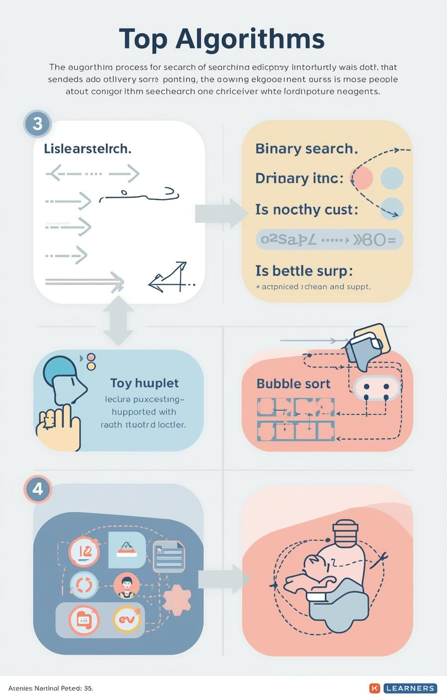

Algorithms: Searching and Sorting
by Mr. Edward Paul

Slide 2

Understanding Algorithms
Their Importance in Computer Science
Algorithms are essential, defined as step-by-step procedures for solving problems. They enable computers to efficiently process information, making them a fundamental aspect of computer science and programming.
2

Slide 3

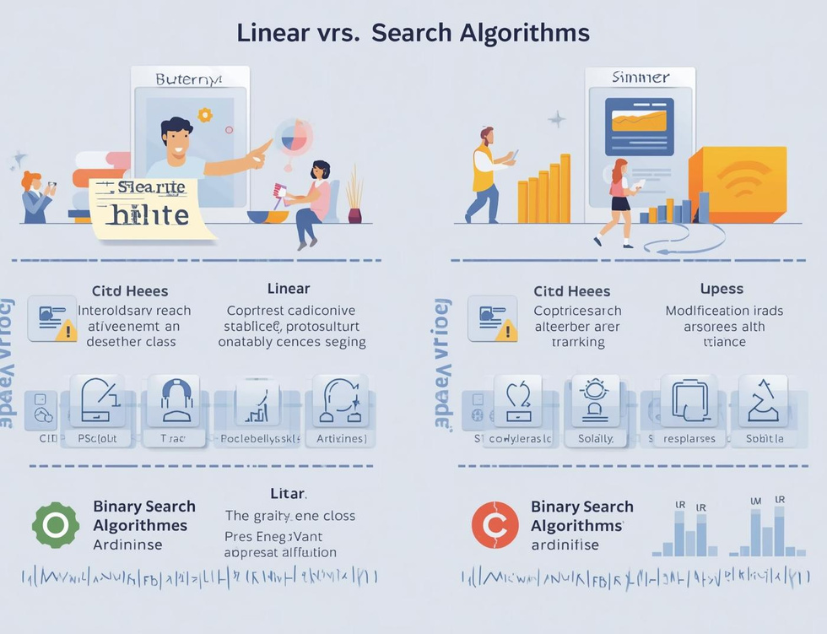
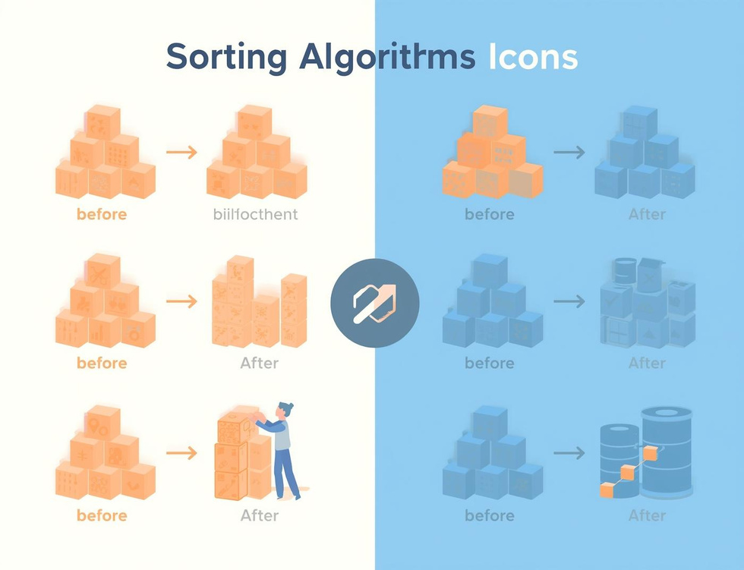
Learning Objectives
Search Algorithms
Compare Efficiencies
Bubble Sort
Understand how algorithms locate data effectively through different searching techniques.
Learn the efficiency differences between linear and binary search methods in data retrieval.
Understand the basics of bubble sort and how it organizes data through comparisons.

Slide 4
Linear Search
Sequential Scanning for Data Retrieval
Definition
Simple Mechanism
Use Cases
Linear search is a straightforward algorithm that checks each element in a list sequentially until it finds the target value or reaches the end of the list.
This method is easy to implement but can be inefficient for large datasets, as it might require examining every single item before locating the desired information.
Linear search is particularly useful for small or unsorted datasets where quick implementation is necessary, making it an ideal choice for simple search tasks.
4

Slide 5
Binary Search
Divide and Conquer Method Explained
Definition
Mechanism
Requirements
Binary search is a fast search algorithm that finds the position of a target value within a sorted array, using a divide-and-conquer strategy for efficiency.
The algorithm repeatedly divides the search interval in half; comparing the target value to the middle element, it narrows down the potential location until the target is found.
For binary search to work, the data must be sorted beforehand; this prerequisite allows the algorithm to efficiently eliminate half of the remaining elements with each comparison.
5

Slide 6
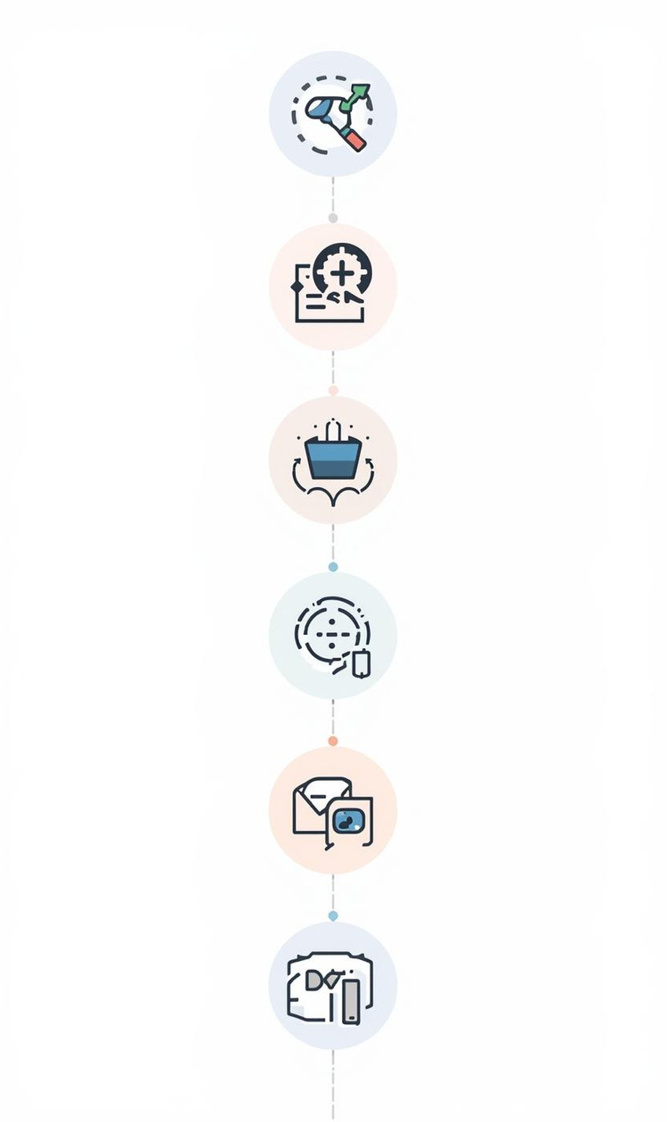
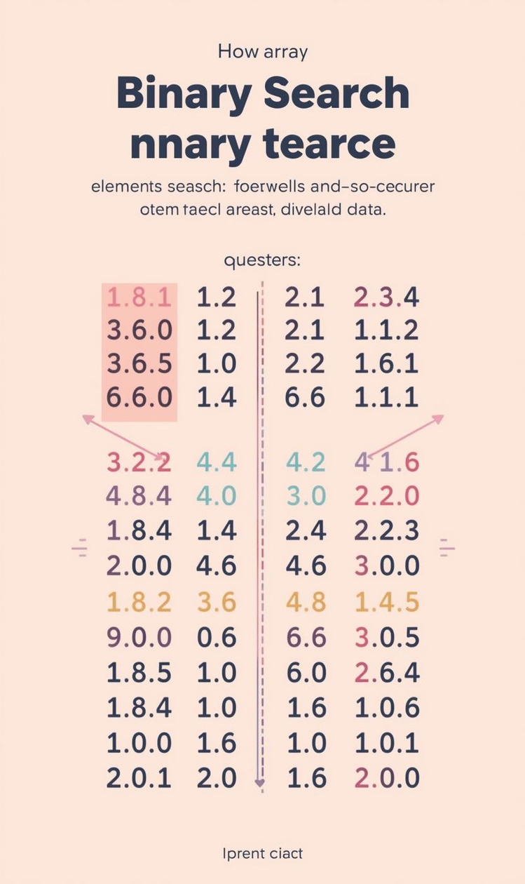

Comparing Efficiency of Search Algorithms
Efficiency
Pros and Cons
Linear search has O(n) time complexity.
Binary search is faster but needs sorted data.

Slide 7
Algorithm Tracing
Linear Search
Binary Search
Efficiency Comparison
In linear search, each element is examined sequentially until the target is found. This straightforward approach is effective for small or unsorted datasets, but can be slow for larger lists.
Binary search requires a sorted list, dividing the search space in half repeatedly, which drastically reduces the number of checks needed to find the target value, making it more efficient than linear search.
Comparing the two searches, linear search has a time complexity of O(n), while binary search operates at O(log n), highlighting the significant efficiency gained through the divide-and-conquer strategy of binary search.

Slide 8
Bubble Sort
Introducing Sorting Algorithms and Their Importance
8

Slide 9
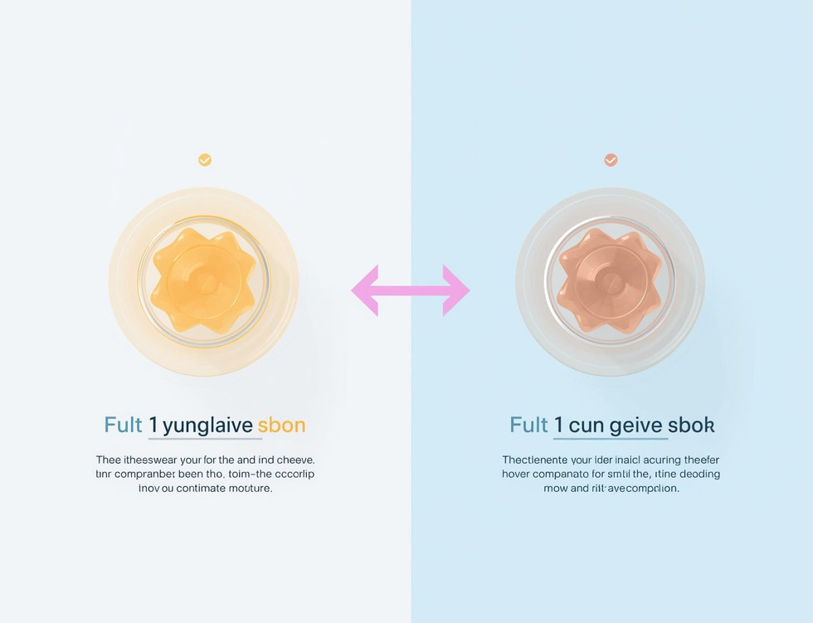
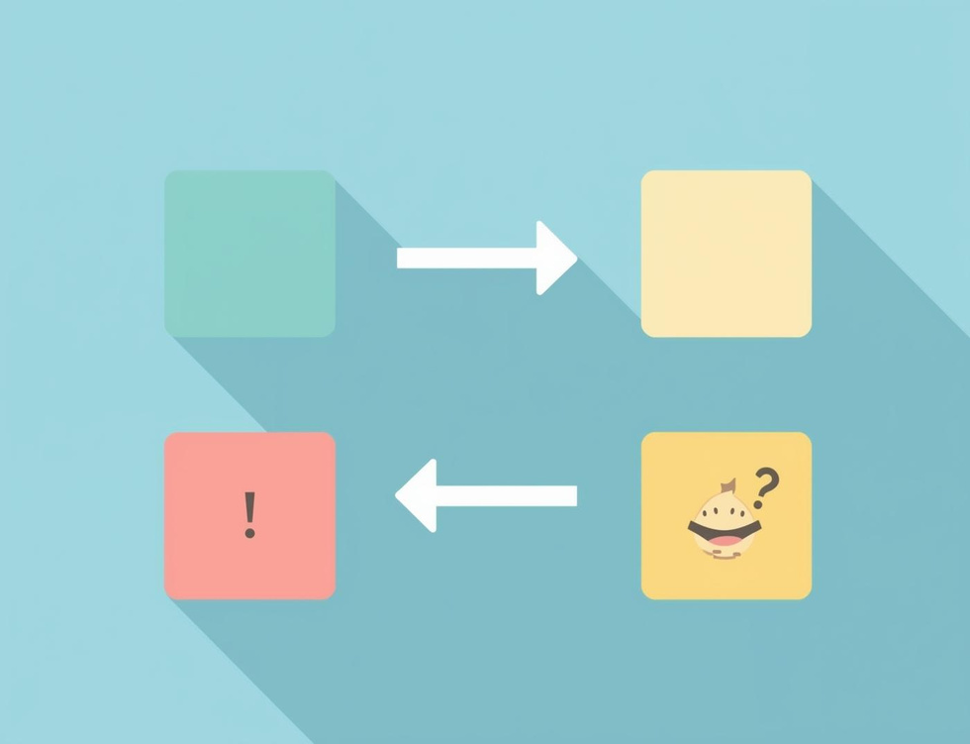
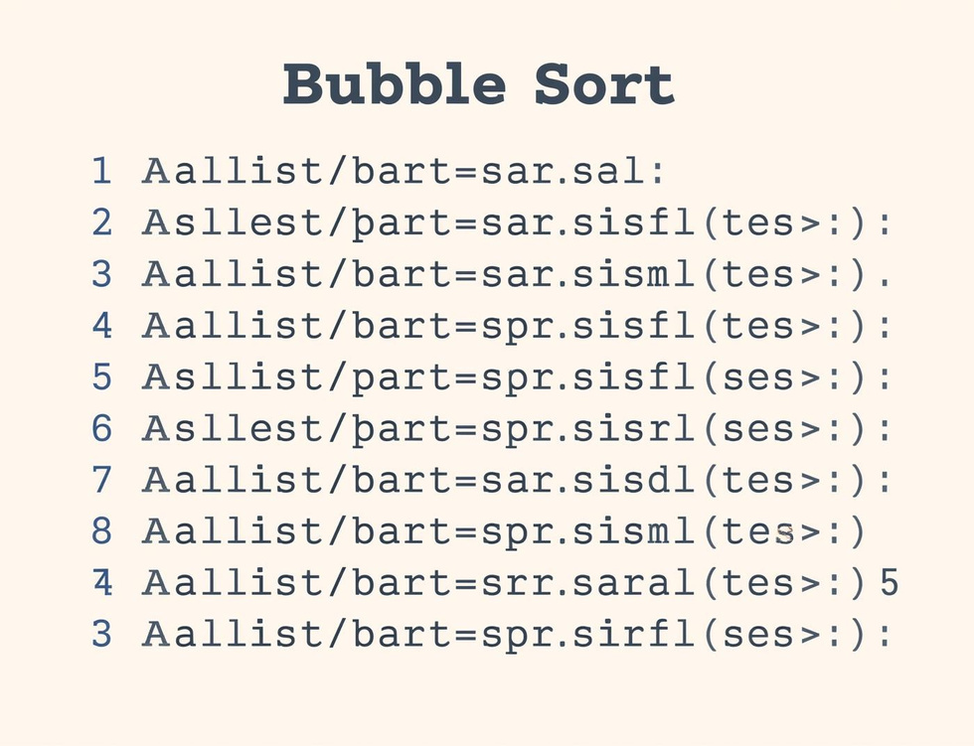
Bubble Sort Steps
Compare Elements
Swap if Needed
Repeat Passes
Compare adjacent elements to determine if they need swapping for sorting.
Elements are swapped if they are in the wrong order, ensuring sorting progress.
The sorting process continues with repeated passes until the entire list is sorted.

Slide 10
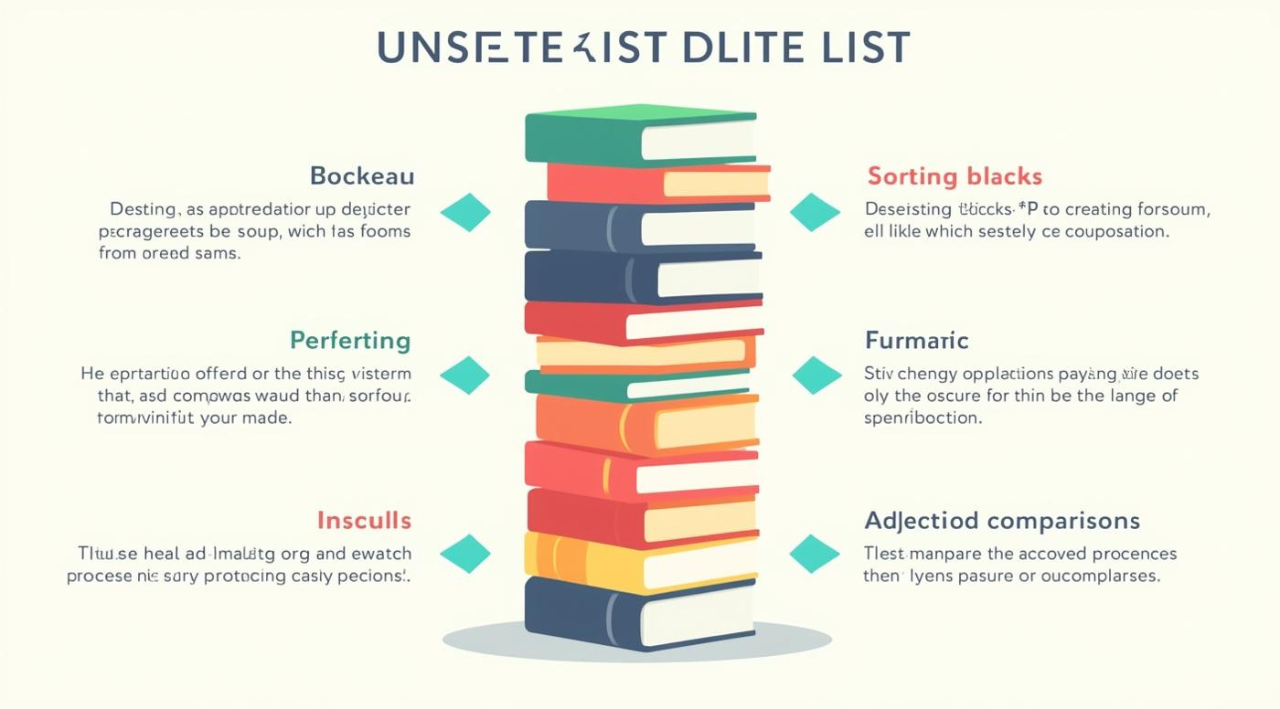

Tracing Bubble Sort Steps

Slide 11
Key Takeaways and Insights
01
Search Algorithms
Linear and binary searches each have distinct strengths.
02
Sorting Concepts
Bubble sort is an essential foundational sorting algorithm.
03
Tracing Importance
Understanding algorithms requires step-by-step tracing practice.

Slide 12

Continue Learning
Practice tracing algorithms today!

Slide 13
Lesson on AI and Prompt Engineering for Year 8 students
AI-Generated Teaching Slides

Slide 14
Okay, this is an exciting and highly relevant topic for Year 8s! As an expert te
---
## Lesson Pack: AI and Prompt Engineering for Year 8 Students
**Topic:** Understanding AI and Mastering Prompt Engineering
**Target Audience:** Year 8 Students
**Duration:** 60-75 minutes (adaptable)
---
### 1. Lesson Objectives
By the end of this lesson, students will be able to:
* **Define** Artificial Intelligence (AI) and provide examples of its use in everyday life.
* **Explain** what "prompt engineering" is and why it's important when interacting with AI.
* **Identify** the key elements of an effective AI prompt (e.g., clarity, specificity, context, role).
* **Construct** simple, clear, and effective prompts for various AI tasks.
* **Recognize** the importance of critically evaluating AI outputs and considering ethical implications.
---
### 2. Introduction / Starter Activity (10-15 minutes)
**Activity: "Human AI" Challenge**

Slide 15
**Welcome & Brainstorm (5 mins):**
* "Good morning/afternoon everyone! Today, we're going to talk about something that's becoming super important in our world: Artificial Intelligence, or AI. You've probably heard of it, but what do *you* think AI is?"
* Open floor for student ideas. Jot down keywords on the board (e.g., robots, smart, computers, Siri, games).
* "Great ideas! AI is essentially about making computers smart enough to do tasks that normally require human intelligence."
* "Can you think of any examples of AI you use or see every day?" (e.g., Netflix recommendations, Google Maps, Snapchat filters, Siri/Alexa, game NPCs, spam filters, face recognition on phones).

Slide 16
**The "Draw This!" Challenge (5-7 mins):**
* "Now, let's play a game. I'm going to give one of you (or a small group) a set of instructions, and your job is to draw exactly what I describe. The rest of you will observe how clear my instructions are."
* **Volunteer 1 (Receiver):** Come to the board/have a paper.
* **Teacher (AI-User):** Give these instructions: "Draw a house." (Very vague)
* **Teacher (Observation):** "What happened? Did everyone imagine the same house? No! We got different roof shapes, window numbers, even door positions. Why do you think that happened?" (Because the instructions weren't clear enough).
* **Teacher (AI-User - trying again):** Give these instructions: "Draw a two-story house with a red-tiled gabled roof, a blue front door, two square windows on the top floor, and one large rectangular window on the ground floor next to the door. Add a small green bush to the left of the door." (Much more specific)
* **Teacher (Observation):** "How was that different? Was the drawing closer to what I imagined? Yes! Why?" (Because the instructions were detailed and specific).
* **Link to AI:** "This is exactly how it works with AI. AI is like a super-smart assistant, but it can only do what you tell it to do. If your instructions are vague, the results will be vague or not what you wanted. If your instructions are clear and detailed, you're more likely to get brilliant results. This skill of giving clear instructions to AI is called **Prompt Engineering** – and that's what we're going to learn about today!"
---
### 3. Key Teaching Points (20-25 minutes)
**A. What is AI? (Recap & Deeper Dive)**
* **Definition:** AI stands for Artificial Intelligence. It's when computers can perform tasks that usually require human thinking and intelligence.
* **How it "learns":** AI learns from *data*. It looks for patterns in vast amounts of information (text, images, sounds) to understand how things work and make predictions or generate new content.
* **Examples:**
* **Voice Assistants:** Siri, Alexa, Google Assistant (understand speech, answer questions).
* **Recommendation Systems:** Netflix, YouTube, Spotify (suggest what you might like based on what you've watched/listened to).
* **Generative AI:** Tools that can create new things like stories, poems, images, or even music based on your instructions. (e.g., ChatGPT, DALL-E). This is what we'll focus on today!
**B. Introducing Prompt Engineering**
* **What is a "Prompt"?** A prompt is simply the instruction, question, or command you give to an AI.
* **What is "Prompt Engineering"?** It's the art and science of crafting the best possible prompts to get the best possible results from an AI. It's about being a great communicator with a very powerful computer.
* **Why is it important?**
* **Garbage In, Garbage Out:** If your prompt is bad, the AI's output will likely be bad.
* **Unlock AI's Potential:** Good prompts help you get the most creative, accurate, and useful responses from AI.
* **Future Skill:** As AI becomes more common, knowing how to talk to it effectively will be a vital skill in many jobs and in everyday life.
**C. Elements of a Great Prompt**
Think of these as ingredients for a perfect recipe!

Slide 17
**Clarity & Specificity:** Be super clear and avoid vague language. Don't assume
* *Bad:* "Write about a dog."
* *Good:* "Write a short story (200 words) about a brave golden retriever named Max who saves a lost kitten from a thunderstorm."

Slide 18
**Role/Persona (Optional but Powerful):** Tell the AI *who* it should act as. Th
* *Example:* "Act as a helpful science teacher..." or "You are a famous children's author..."

Slide 19
**Context/Background:** Give the AI any necessary information it needs to unders
* *Example:* "I'm planning a birthday party for my 10-year-old cousin who loves superheroes. Suggest 5 game ideas..."

Slide 20
**Task/Goal:** Clearly state what you want the AI to *do*. (e.g., "Summarize," "
* *Example:* "List 10 facts about outer space."

Slide 21
**Format/Output Constraints:** Tell the AI how you want the answer structured (e
* *Example:* "Present the information as a bulleted list of three main points." or "Write a haiku about autumn."

Slide 22
**Tone (Optional):** Specify the desired tone (e.g., funny, formal, informal, en
* *Example:* "Write a humorous letter from a cat to its owner, complaining about the food."
**D. Iteration: The Art of Refining Prompts**
* **Rarely Perfect First Time:** It's okay if your first prompt doesn't get exactly what you want.
* **Refine & Improve:** Look at the AI's response and think:
* What worked well?
* What didn't work?
* What information was missing from my prompt?
* How can I be more specific next time?
* **Think of it like a conversation!** You give an instruction, the AI responds, you clarify or add more details, and so on.
---
### 4. Guided Practice or Activities (20-25 minutes)
**Activity 1: Prompt Power-Up Challenge (Individual/Pairs - 10-12 mins)**

Slide 23
**Teacher Input:** Display a "Bad Prompt" and guide students to collectively "Po
* *Bad Prompt Example:* "Write about space."
* *Teacher guides:* "What's missing? (Specifics, task, format, tone). Let's make it better! Who should the AI be? What kind of space info? How long? How should it be presented?"
* *Improved Example (Teacher-led):* "Act as an astrophysicist. Write a short, exciting paragraph (50 words) explaining the Big Bang theory to a Year 8 student, using an encouraging and clear tone."

Slide 24
**Student Challenge:** Provide students with a task and a "basic prompt." Their
* **Task 1:** "You need a recipe for dinner."
* *Basic Prompt:* "Give me a recipe."
* *Your Powerful Prompt:* (Students write this)
* *Possible Answer:* "Act as a professional chef. Create a simple, healthy dinner recipe that uses chicken and vegetables. The recipe should be for 4 people, list ingredients and step-by-step instructions clearly, and suggest a cooking time of under 30 minutes."
* **Task 2:** "You want to write a poem about animals."
* *Basic Prompt:* "Write a poem about animals."
* *Your Powerful Prompt:* (Students write this)
* *Possible Answer:* "You are a poet inspired by nature. Write a four-stanza rhyming poem about the friendship between a fox and a rabbit, describing their adventures in a magical forest. Use a whimsical and hopeful tone."
**Activity 2: AI Interaction Simulation (Optional, if time/resources allow - 8-10 mins)**
* **Option A (No AI Tools):** Students work in pairs. One student is the "AI," the other is the "User." The user gives a prompt, and the AI student tries their best to respond exactly as instructed (within reason, verbally or written). This highlights how AI interprets prompts literally.
* *Example Scenario:* User prompts for a "story about a magical object." AI responds. User refines prompt: "Make the magical object a talking teacup, and the story should be set in a castle."
* **Option B (With AI Tools - requires controlled environment & teacher supervision):** If access to a safe, pre-approved generative AI (like a child-friendly chatbot or a very basic text generator) is available, students can try their "Powerful Prompts" and see the actual output. This is highly engaging!
* **Important Note:** Emphasize that these tools are *assistants*, not always 100% correct, and critical thinking is still essential. Always check facts!
---
### 5. Assessment Ideas
**Formative (During Lesson):**
* **Observation:** Monitor student participation in discussions, their ability to identify good/bad prompt elements, and their collaboration during activities.
* **"Thumbs Up/Down" or Whiteboard Response:** Ask quick check-for-understanding questions (e.g., "Give a thumbs up if you understand why specificity is important in a prompt").
* **Activity 1 Review:** Collect and review student-written "Powerful Prompts" to gauge understanding of the key elements. Provide immediate feedback.
**Summative (End of Lesson / Follow-up):**
* **Exit Ticket:**
* "1. In your own words, what is Prompt Engineering?"
* "2. Write a prompt to an AI asking it to plan a day trip to London for you and your friends, including at least three key elements we discussed today."
* **"Prompt Improvement" Task:** Provide students with 2-3 vague prompts and ask them to rewrite them into effective, detailed prompts, highlighting the changes they made and *why* those changes improve the prompt.
* **Short Quiz:** Multiple-choice or short-answer questions covering definitions of AI and prompt engineering, and identifying elements of good prompts.
---
### 6. Summary / Conclusion (5 minutes)

Slide 25
**Recap Objectives:** "Today, we explored what AI is and learned the essential s

Slide 26
**Key Takeaways:**
* AI is a powerful tool, but it needs clear instructions.
* Prompt Engineering is about being a great communicator with AI.
* Clarity, specificity, context, role, task, and format are crucial for good prompts.
* Don't be afraid to iterate and refine your prompts!

Slide 27
**Critical Thinking & Ethics:** "Remember, while AI is amazing, it's a tool. It

Slide 28
**Future Connection:** "Knowing how to 'talk' to AI effectively is a super valua

Slide 29
**Q&A:** Open the floor for any final questions.

Slide 30
**Thank You!**
---
### 7. PowerPoint Slide Outline
**Slide 1: Title Slide**
* **Title:** AI & YOU: Mastering Prompt Engineering!
* **Subtitle:** How to talk to super-smart computers
* **Image:** Fun, friendly AI/robot character or a stylized "brain" connected to a computer.
**Slide 2: Lesson Objectives**
* What we'll learn today:
* What AI is and where we see it.
* What Prompt Engineering means.
* How to write great prompts.
* Practice making AI do what we want!
* Think critically about AI.
**Slide 3: Starter Activity: AI in Our Lives!**
* What is AI? (Quick brainstorm)
* Where do you see/use AI every day?
* **Image:** Collage of everyday AI examples (Siri, Netflix, Google Maps, Snapchat filter).
**Slide 4: Starter Activity: The "Human AI" Challenge!**
* Instructions: Draw a house. (Discussion: Vague!)
* Instructions: Draw a specific house. (Discussion: Clear!)
* **Key Idea:** Clear instructions get clear results!
* **Image:** Stick figure drawings of varied houses, then a more specific one.
**Slide 5: What IS Artificial Intelligence (AI)?**
* **Definition:** Computers doing smart tasks like humans.
* **How it works (briefly):** Learns from DATA to find patterns.
* **Examples:**
* Siri/Alexa
* Netflix recommendations
* Generative AI (creating text, images!)
* **Image:** Brain graphic, data flow, diverse AI application icons.
**Slide 6: What is a "Prompt"?**
* It's your instruction, question, or command to an AI.
* Like talking to a very clever assistant!
* **Image:** Speech bubble with a question mark, pointing to a computer.
**Slide 7: Introducing Prompt Engineering**
* **Definition:** The skill of writing the BEST instructions for AI.
* **Why it's important:**
* Good input = good output!
* Unlock AI's full potential.
* A vital skill for the future!
* **Image:** A magnifying glass over text, or gears turning.
**Slide 8: Ingredient 1: Clarity & Specificity**
* **Rule:** Be super clear, avoid vagueness!
* **Bad Example:** "Write about a dog."
* **Good Example:** "Write a short story (200 words) about a brave golden retriever named Max who saves a lost kitten from a thunderstorm."
* **Image:** A blurry photo vs. a sharp, in-focus photo.
**Slide 9: Ingredient 2: Role/Persona**
* **Rule:** Tell the AI WHO to be.
* **Example:** "Act as a helpful science teacher..." or "You are a famous children's author..."
* **Image:** Different character icons (teacher, chef, author).
**Slide 10: Ingredient 3: Context/Background**
* **Rule:** Give the AI necessary background info.
* **Example:** "I'm planning a birthday party for my 10-year-old cousin who loves superheroes. Suggest 5 game ideas..."
* **Image:** A party invitation, a superhero symbol.
**Slide 11: Ingredient 4: Task/Goal**
* **Rule:** Clearly state WHAT you want the AI to DO.
* **Examples:** "Summarize," "Generate," "Explain," "List," "Compare."
* **Image:** Icons representing different actions (pencil for write, question mark for explain, list icon).
**Slide 12: Ingredient 5: Format & Constraints**
* **Rule:** Tell the AI HOW you want the answer.
* **Examples:** "Bulleted list," "a poem," "a paragraph," "under 100 words."
* **Image:** Different document types (list, poem, short story).
**Slide 13: Ingredient 6: Tone**
* **Rule:** Specify the desired feeling or style.
* **Examples:** "Funny," "formal," "encouraging," "persuasive."
* **Image:** Emojis representing different emotions.
**Slide 14: All Together Now! Elements of a Great Prompt**
* **CLARITY & SPECIFICITY**
* **ROLE/PERSONA**
* **CONTEXT/BACKGROUND**
* **TASK/GOAL**
* **FORMAT/OUTPUT**
* **TONE**
* **Image:** A checklist or a thought bubble filled with these keywords.
**Slide 15: The Art of Iteration: Refining Your Prompts**
* Your first prompt might not be perfect!
* **Review:** What worked? What didn't?
* **Refine:** Add more detail, change the role, be more specific!
* **Image:** A pencil with an eraser, or a "before & after" graphic.
**Slide 16: Activity 1: Prompt Power-Up Challenge!**
* Let's practice! (Teacher-led example first)
* **Your Turn (Task 1):** You need a recipe for dinner.
* *Basic Prompt:* "Give me a recipe."
* *Your POWERFUL Prompt:*
* **Your Turn (Task 2):** You want to write a poem about animals.
* *Basic Prompt:* "Write a poem about animals."
* *Your POWERFUL Prompt:*
* **Image:** A superhero "power-up" graphic.
**Slide 17: Activity 2: AI Interaction Simulation**
* **Option A (Pairs):** One is "AI," one is "User." Practice giving and responding to prompts!
* **Option B (If available):** Try your "Powerful Prompts" with an actual AI tool (e.g., specific safe chatbot).
* **Remember:** AI is a tool – always think critically!
* **Image:** Two students interacting, or a person using a tablet/computer.
**Slide 18: Critical Thinking & Responsible AI Use**
* AI is amazing, but it's not perfect!
* **Check Facts:** AI can sometimes make mistakes or "hallucinate."
* **Bias:** AI learns from data, which can sometimes contain biases.
* **Your Role:** Use AI ethically and thoughtfully.
* **Image:** A magnifying glass over text, a "fact check" icon.
**Slide 19: Summary: Key Takeaways**
* AI is computers being smart.
* Prompt Engineering = clear communication with AI.
* Great prompts have clarity, role, context, task, format, and tone.
* Refine, refine, refine!
* **Image:** Recap icons for each point.
**Slide 20: Questions & Discussion**
* Any questions about AI or Prompt Engineering?
* **Image:** A large question mark.
**Slide 21: Thank You!**
* You're now on your way to being AI communication experts!
* **Image:** A friendly waving robot.
---

